Slide 1
Team Members
SP
Vineet Kumar
AI, Backend, Voice, Chat
Vritika Malhotra
StudyPilot
Dashboard, UI Components
Disha Jadav
AI-Powered Study Dashboard
Assignments, Calendar
CMPE 280 — Web UI Design & Development
Spring 2026 | San Jose State University
Instructor: Dr. Xiuduan Fang
Kumar Harsh
Todos, Tests, Animations
Sriram Lakumarapu
TEAM 14
PostgreSQL, API, Docker
Notes:
Sriram

Slide 2
Problem Statement
Why does StudyPilot need to exist?
"College students juggle Canvas, Google Calendar, random note apps, and scattered tools — with no single place to see everything, plan smarter, and get help instantly."
📅
Fragmented Tools
🧠
Mental Overload
Canvas for assignments, Google Cal for events, note apps for todos — never in sync
Deadlines tracked in their heads, leading to missed work and poor time management
🔇
No Accessibility
🤖
No Intelligent Help
Most tools require keyboard & mouse — unusable for students with motor disabilities
Static apps can't analyze your workload and suggest what to study next
Notes:
Sriram

Slide 3
Our Solution
StudyPilot is a unified AI-powered study companion that replaces the scattered mess of student productivity tools with one intelligent dashboard.
Student
Dashboard
AI Engine
Response
▶
▶
▶
📋
Todo Manager
📚
Assignment Tracker
📅
Calendar
Full CRUD + AI task suggestions
Status tracking + AI tutor per assignment
Month grid + agenda view + events
💬
AI Chat
🎤
Voice Assistant
📊
Dashboard
Streaming GPT-5.2 with history
Hands-free full app control
Unified overview + study plan
Notes:
Ritika

Slide 4
Key Features
What makes StudyPilot stand out
01
4 AI-Powered Features
02
Voice-First Interface
Chat, Study Plan Generator, Assignment AI Tutor, and Todo Suggestions — all backed by GPT-5.2 with real-time SSE streaming so responses appear word-by-word.
Full hands-free control via "Hey StudyPilot" wake word. Create todos, navigate pages, and ask AI questions — all by voice. Built with Azure Neural STT/TTS.
GPT-5.2
Streaming
Azure OpenAI
Azure Speech
Wake Word
Accessibility
03
Secure Full-Stack Auth
04
87%+ Test Coverage
JWT authentication with httpOnly cookies, bcrypt password hashing, and complete user-scoped data isolation. Every API route verifies resource ownership.
315 unit tests across 52 test files using Vitest and React Testing Library. All hooks, components, pages, and context providers are covered.
JWT
bcryptjs
Prisma ORM
315 Tests
Vitest
RTL
Notes:
Disha

Slide 5
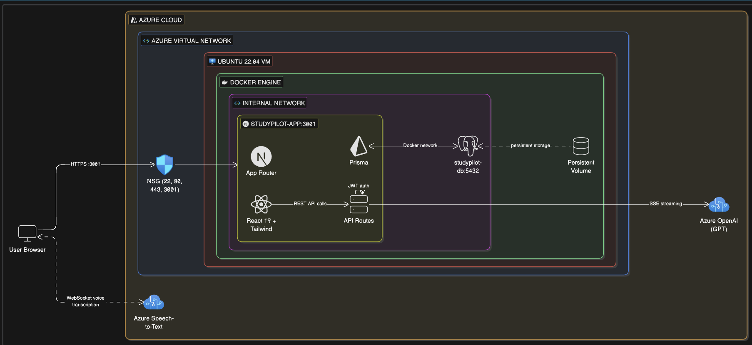
System Architecture
Azure Ubuntu VM · Docker Compose · Full-Stack Next.js
postgresql
Notes:
Harsh

Slide 6
Tech Stack
Modern, production-grade tools chosen for speed, type safety, and developer experience
FRONTEND
BACKEND & DATABASE
Next.js 16 (App Router)
PostgreSQL 16
React 19 + TypeScript
Prisma ORM v6
Tailwind CSS v4
19 RESTful API Routes
Framer Motion 12
JWT + bcryptjs Auth
Radix UI Primitives
Docker Compose
AI & VOICE
TESTING & DEVOPS
Azure OpenAI GPT-5.2
Vitest + React Testing Lib
Server-Sent Events
315 Tests / 87% Coverage
Azure Speech SDK
Azure Ubuntu VM
Neural TTS JennyNeural
Docker Multi-Stage Build
Wake Word Detection
GitHub CI

Slide 7
Future Improvements
Where StudyPilot goes next
v1.1
📱 Native Mobile App
v1.1
🔗 Canvas LMS Integration
React Native port with offline support and push notifications for assignment deadlines and calendar reminders
OAuth2 connection to Canvas to auto-import assignments, grades, and deadlines — no manual entry needed
v1.2
👥 Collaborative Study Rooms
v1.2
📈 Study Analytics Dashboard
Real-time shared workspaces where study groups can co-edit notes, share AI responses, and track group tasks via WebSockets
Visualize study patterns, completion rates, and focus time with interactive charts. AI coaching suggests habit improvements
v2.0
🧠 Personalized AI Tutor
v2.0
♿ Enhanced Accessibility
Fine-tuned model trained on each student's notes, syllabus content, and past interactions for truly personalized explanations
Eye-tracking control, switch access support, dyslexia-friendly fonts, and AI-generated image descriptions for visual content

Slide 8
Demo
StudyPilot
One dashboard. Every tool. Zero switching.
CMPE 280 · Team 14 · Spring 2026 · San Jose State University

